Slide 1
Project: SCUBa
System for the Control of Underwater Buoyancy
Jonathon Houda
Mentor: Shea Ferring
Space Grant Symposium
University of Arizona, Tucson, AZ
April 20–21, 2012
Project: SCUBa
Space Grant Symposium
Arizona State University
NASA Space Grant Robotics

Slide 2
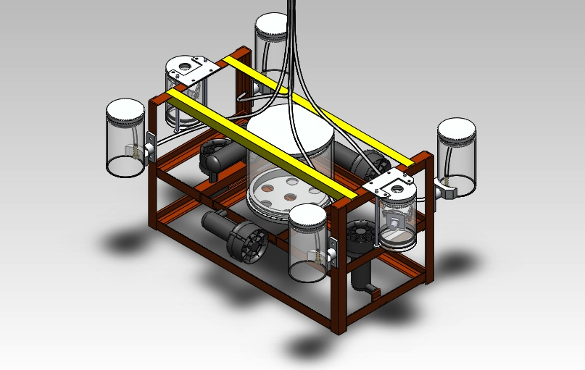
SCUBa Modules
SCUBa installed on “Aqua Devil”
Project: SCUBa
Space Grant Symposium
Arizona State University
NASA Space Grant Robotics
Notes:
Pneumatic tubing running along with the tether

Slide 3
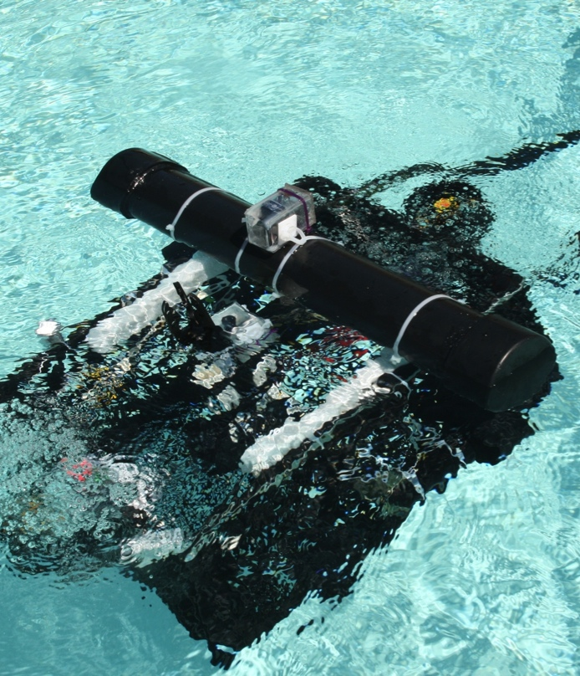
Why Buoyancy?
In past years, buoyancy has usually been last minute
Makes it a priority
Allow greater control and maneuverability
Carry much greater loads
Buoyancy on 2009 ROV
Project: SCUBa
Space Grant Symposium
Arizona State University
NASA Space Grant Robotics

Slide 4
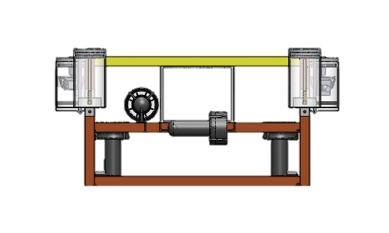
Project Requirements
To further develop systems of NASA Space Grant robotics team
Adaptive system
Pitch control
Semi-autonomy
Significant improvement over static system
Pitch Control with Pivoting Mounts
Project: SCUBa
Space Grant Symposium
Arizona State University
NASA Space Grant Robotics

Slide 5
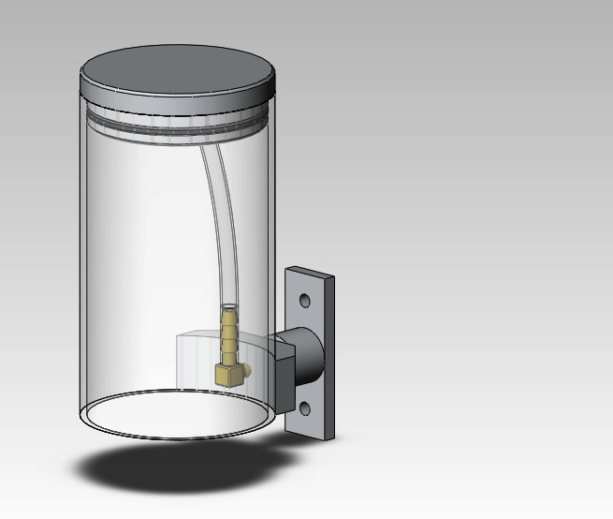
Capabilities
Provides buoyancy control for specific environments (salt vs. fresh)
Allows neutral buoyancy to adapt when mass changes (picking up an object)
Allows lift of heavier objects underwater
Ascend very rapidly
Greater control over tilt of robot
O-ring Seal
Air Inlet/Exit Tube
Air Reservoir
Pivoting Mount
Open System
SCUBa Module Design #1
Project: SCUBa
Space Grant Symposium
Arizona State University
NASA Space Grant Robotics

Slide 6
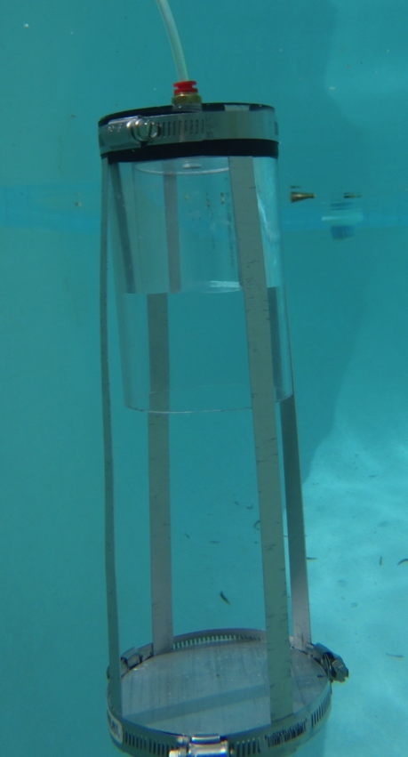
Contingency Analysis
What if robot flips over?
What if leaks occur?
What if air supply is lost?
What if robot goes too deep?
Test Platform for Single Module
Project: SCUBa
Space Grant Symposium
Arizona State University
NASA Space Grant Robotics

Slide 7
SCUBa Test Platform
Project: SCUBa
Space Grant Symposium
Arizona State University
NASA Space Grant Robotics

Slide 8
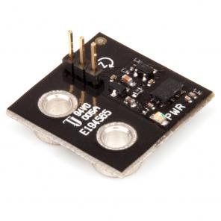
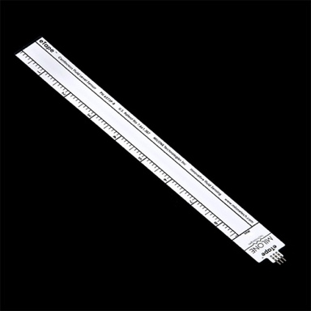
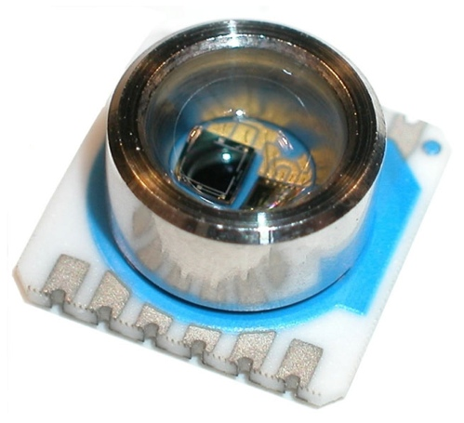
Sensor Integration
Liquid Level Sensor
Pressure Sensor
Gyroscope
Gyroscope
Liquid Level Sensor
Pressure Sensor
Project: SCUBa
Space Grant Symposium
Arizona State University
NASA Space Grant Robotics

Slide 9
Application
Well Cap from MATE Competition in 2011
Weight: 2.3 lbs.
Volume: 30 in³
Buoyant Force: 1.1 lbs
Net Force: 1.2 lbs ⬇
1 SCUBa module can compensate for this added weight
Well head Cap Design
Project: SCUBa
Space Grant Symposium
Arizona State University
NASA Space Grant Robotics

Slide 10
Conclusion
Overview
Priority for 2012
Greater Control of ROV
Maneuver Greater Loads
Currently being implemented onto ROV
Future Considerations
Rigid body container
Waterproof motor for actuation
Other variable volume devices
Project: SCUBa
Space Grant Symposium
Arizona State University
NASA Space Grant Robotics

Slide 11
Questions?
Project: SCUBa
Space Grant Symposium
Arizona State University
NASA Space Grant Robotics

